Slide 1
Does Singapore Place Great Emphasis On Education?
Analysis By: Toh Kien Yu (P2222291)

Slide 2
Roadmap
Nature Of Datasets
Insights from analysis + Data Cleaning
References
Conclusion

Slide 3
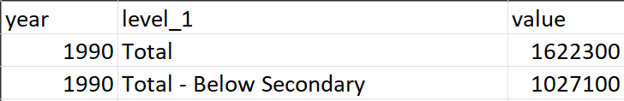

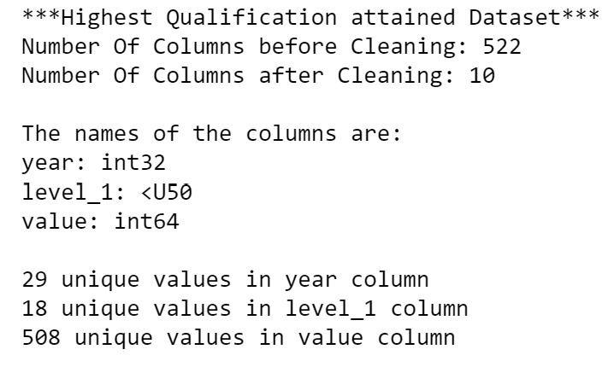
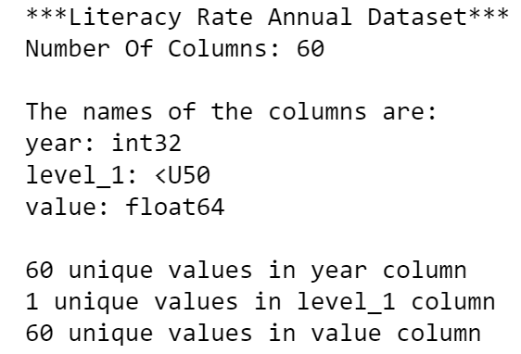
Nature of Dataset (Field Name, Description, Example)
Highest Qualification Attained Dataset
year: Year
level_1: Highest Qualification Attained
value: Number of highest qualification attained
Literacy Rate Dataset
year : Year
level_1: Literacy Rate (15 Years & Over)
value: Percentage of Literacy Rate

Slide 4
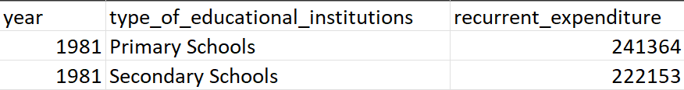
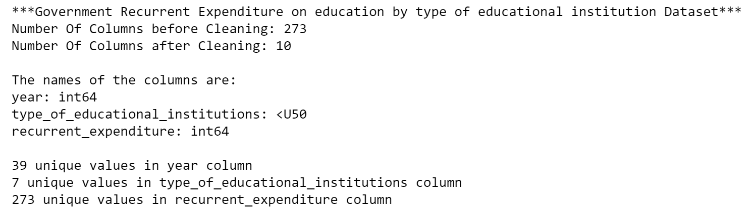
Nature of Dataset (Field Name, Description, Example)
Recurrent Expenditure On Education Dataset
Year: Year
type_of_educational_institutions: Primary Schools, Secondary Schools,Junior Colleges/ Centralised Institutions,Polytechnic,Universities
recurrent_expenditure: Amount spent on respective institutions

Slide 5
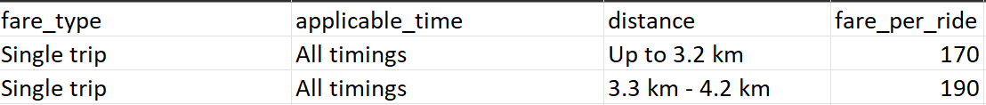
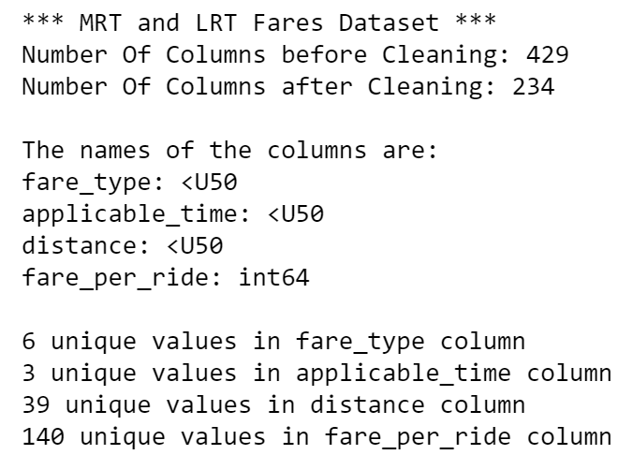
Nature of Dataset (Field Name, Description, Example)
Fares for MRT and LRT Dataset
fare_type: Single Trip, Adult Card Fare,
Student Card Fare, Senior Card Fare
applicable_time: All timings, Before 7:45am (Weekdays excluding public holidays), All other timings
distance: Distance travelled in MRT and LRT
fare_per_ride: Amount paid per ride

Slide 6
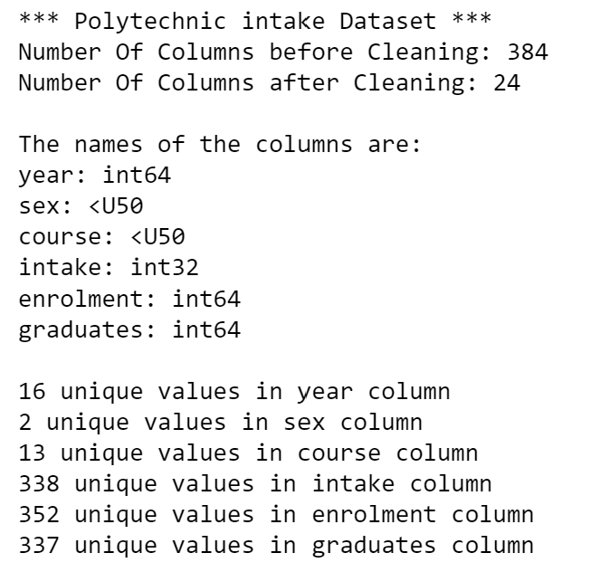
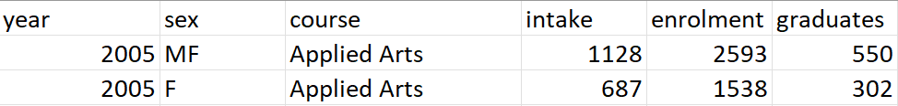
Nature of Dataset (Field Name, Description, Example)
Polytechnic intake Dataset
year: Year
sex: Gender (MF, F)
course: Course Name
intake: number of intake
enrolment: number of enrolment
graduates: number of graduates

Slide 7
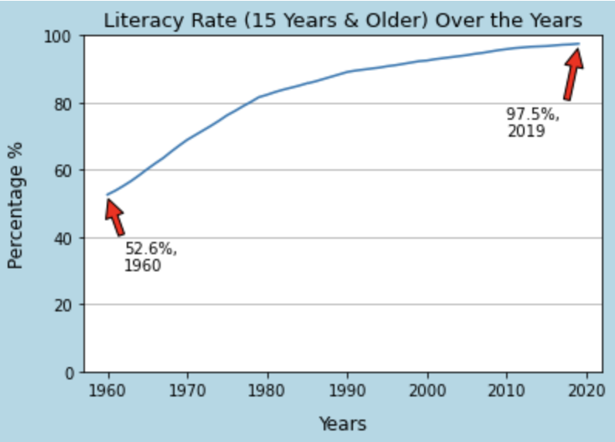
Analysis: Does Singapore Place Great Emphasis On Education?
From the line chart, it can be seen that the percentage of literacy rate (15 Years & Older) over the years in Singapore increased from 52.6% in Year 1960, to 97.5% in Year 2019.
From Year 1960 to 1990, the line rose significantly. After year 1990, the line then increased gradually till 2019.
From the increase in literacy rate, we can conclude that Singapore has places an increasingly emphasis on education which is evidently explained by the trend.

Slide 8
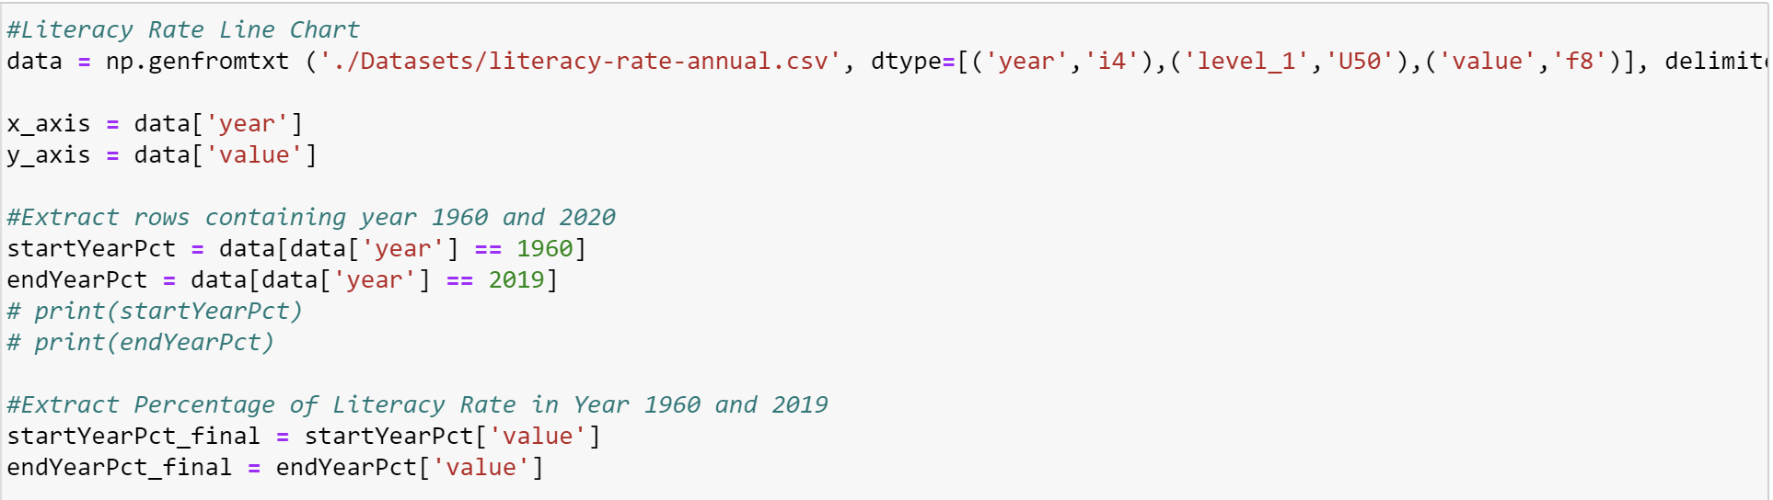
Cleansing of Data: Line Chart
Extract the Rows needed (Year 1960 and 2020)
Extract the values (pct) in both years.
Plot the graph using matplotlib

Slide 9
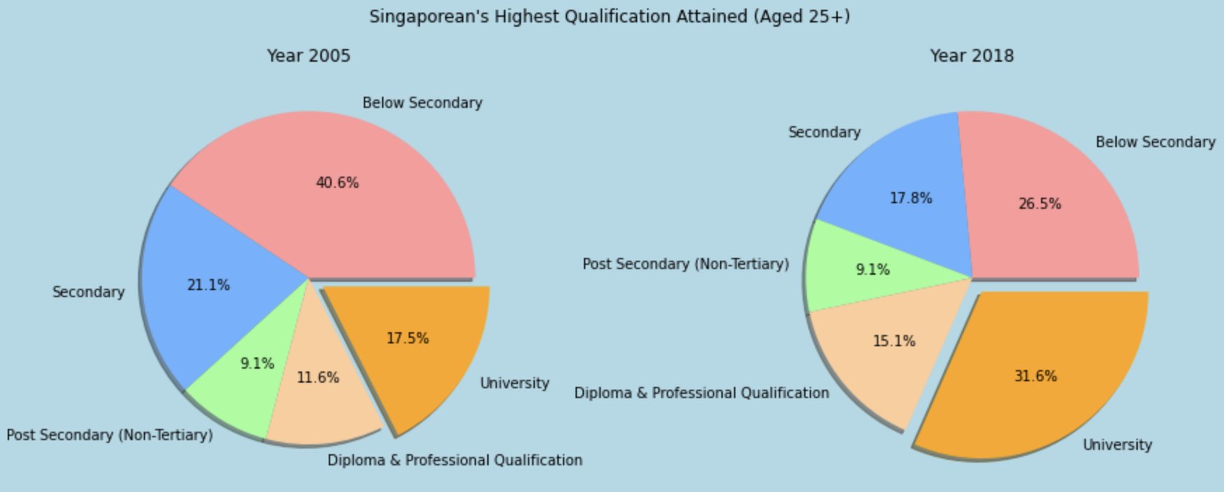
Analysis: Does Singapore Place Great Emphasis On Education?
From this two pie chart, it can be seen that the a Singaporean’s Highest Qualification Attained (Aged 25+) of University increased from 17.5% in year 2005 to 31.6% in Year 2018.
This shows that over the years, citizen have increasing access to education which attributes to the rise in University Qualifications attained. Thus, it also display that the Government does place emphasis in this aspect.
In contrast, the Highest Qualification Attained (Aged 25+) of below secondary dropped from 40.6% in year 2005 to 26.5% in year 2018.
The increase in emphasis on Education by the Government has also shifted society’s expectations on Education Level and therefore a societal trend in pursuing education beyond the Secondary level.

Slide 10
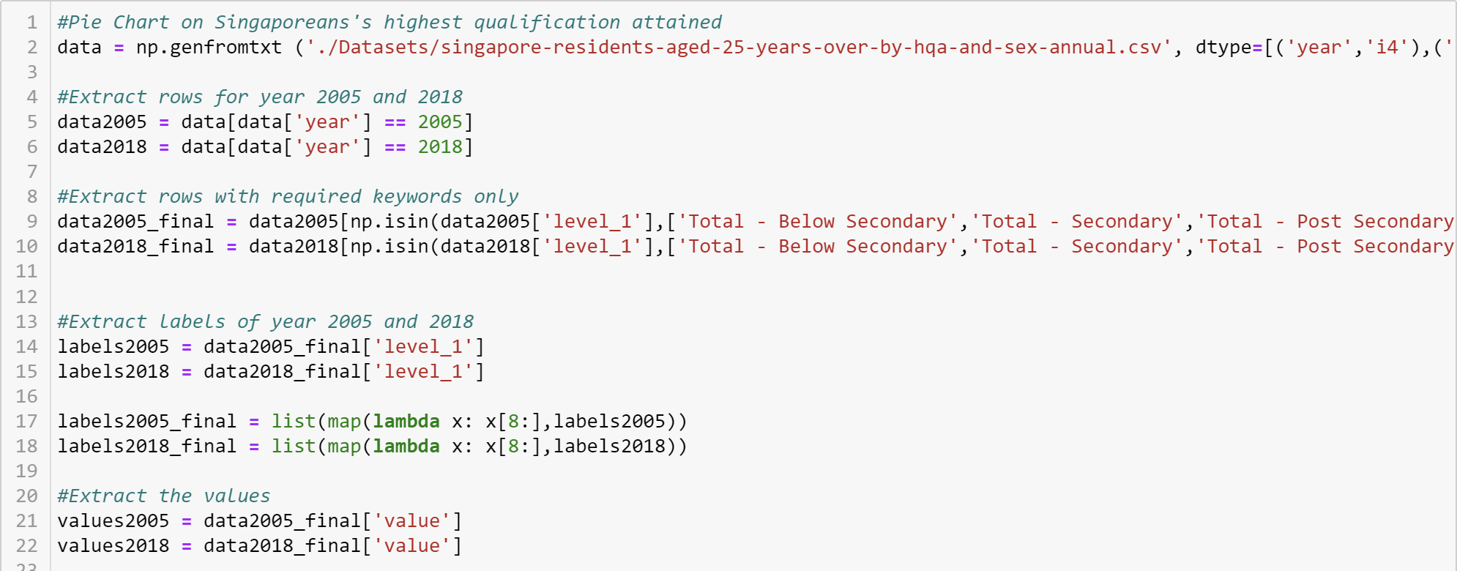
Cleansing of Data: Pie Chart
Extract only the needed rows, Year 2005 and 2018 with a function np.isin
Extract the x axis labels, used a lambda function to remove repetitive (Total - ) in front of the labels.
Extracted the y axis values
Plot the Graph using matplotlib

Slide 11
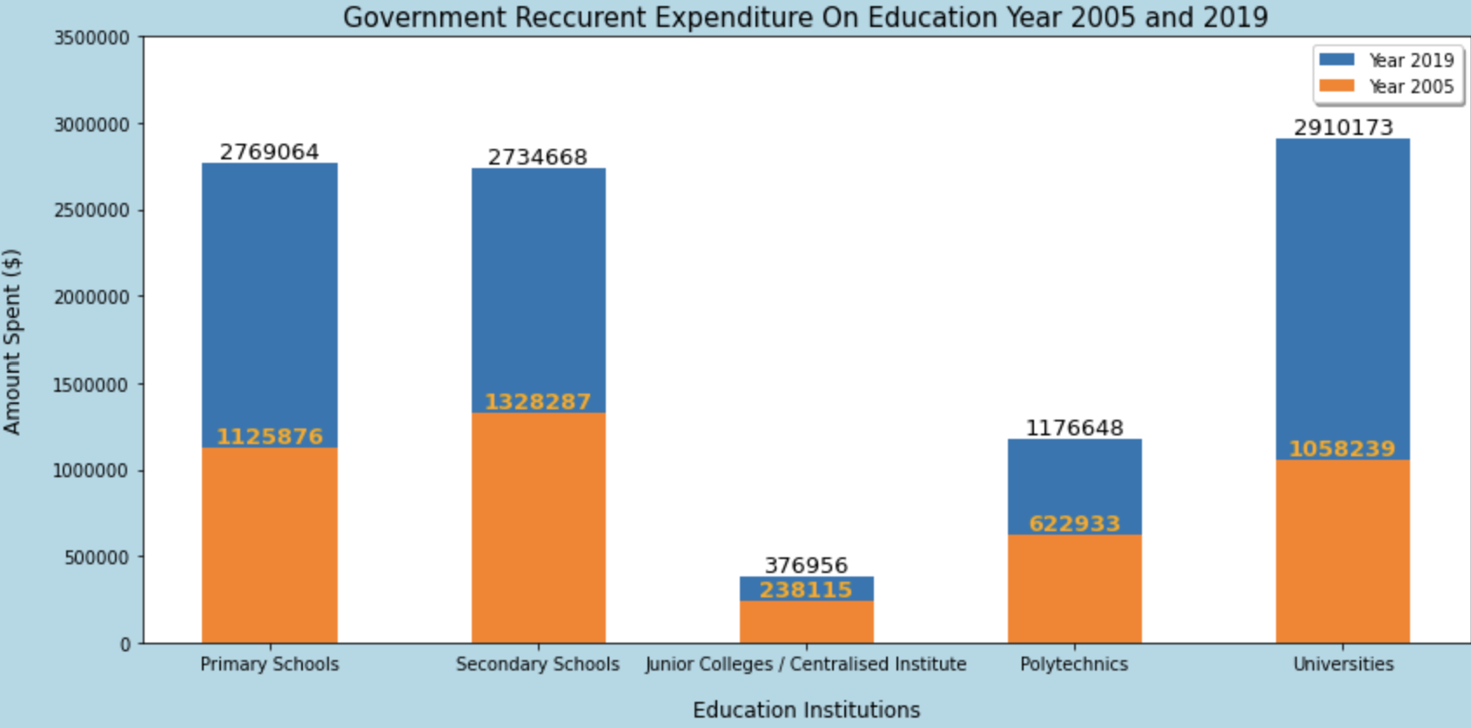
Analysis: Does Singapore Place Great Emphasis On Education?
From the bar chart, it can be seen that the Government’s Recurrent Expenditure on Education has increased tremendously.
The amount spent increased from 2005 - 2019:
Primary School: $1,125,876 to $2,769,064.
Secondary School: $1,328,287 to $2,734,668
University: $1,058,239 to $2,910,173
The amount spent in 2019 for primary school and secondary school doubled and University almost tripled compared to year 2005.
This shows that the government is allocating a higher budget and resources for education in hopes to improve the learning environment that students are exposed at a young age. A learning environment with comprehensive resources can aid one’s learning extensively.

Slide 12
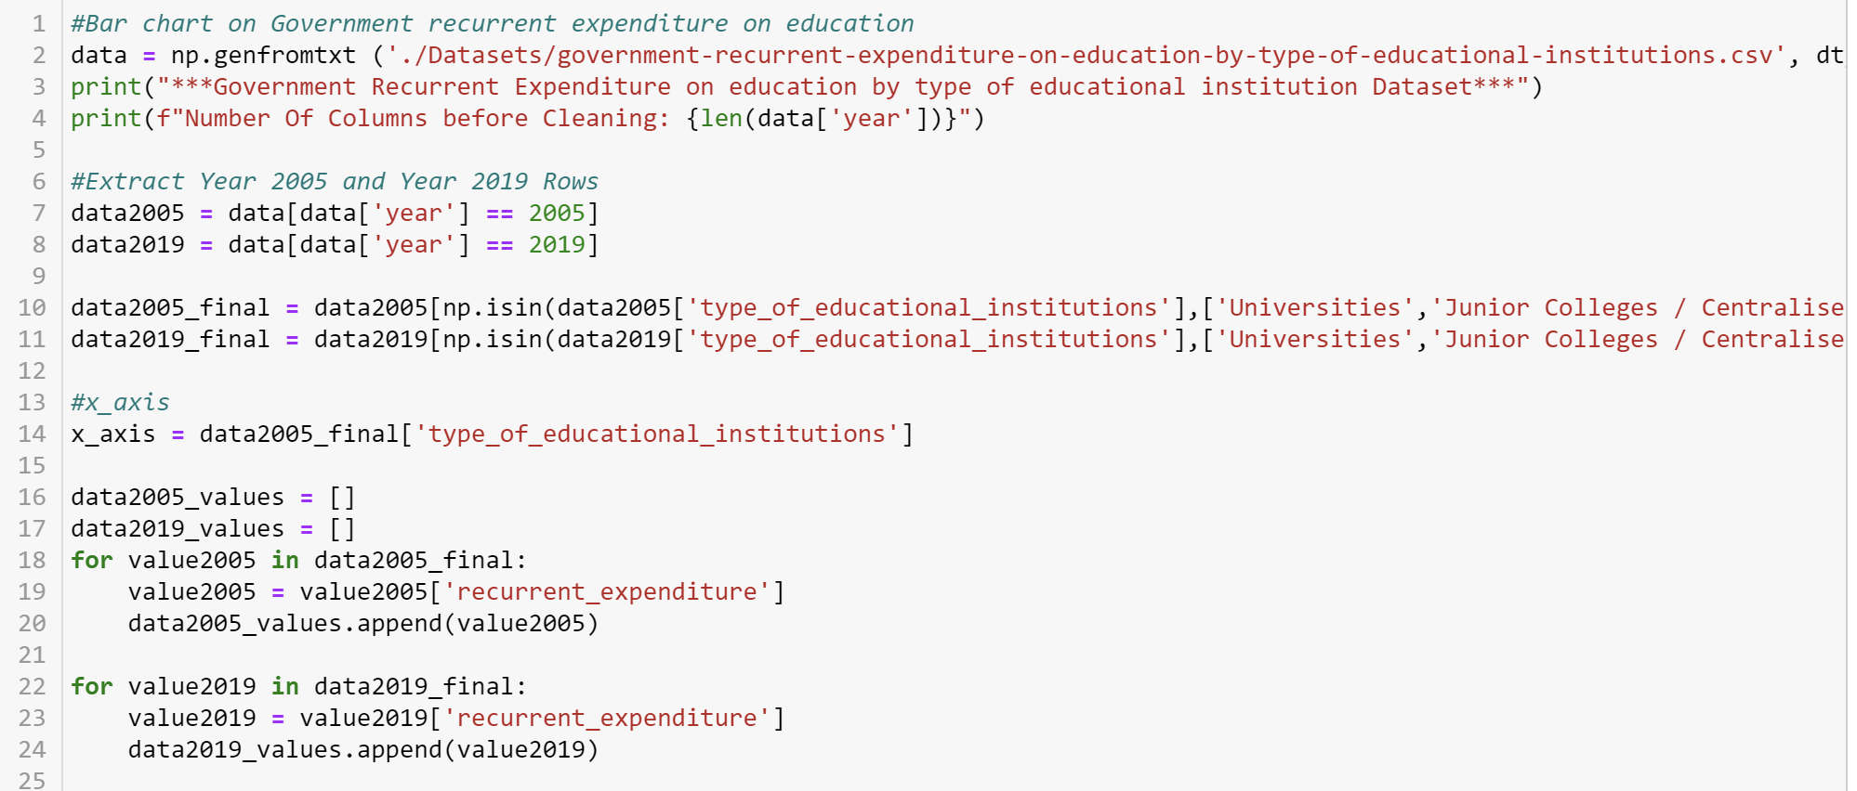
Cleansing of Data: Bar Chart
Extracted Year 2005 and 2019 rows
Extracted only rows that are needed with np.isin to extract the Universities, Junior Colleges / Centralised Institutions, Secondary School etc. rows
Obtain x axis value
Using for loop, I obtained the y axis values for both years then used .append() to push them to their respective array
Plot the Graph using matplotlib

Slide 13
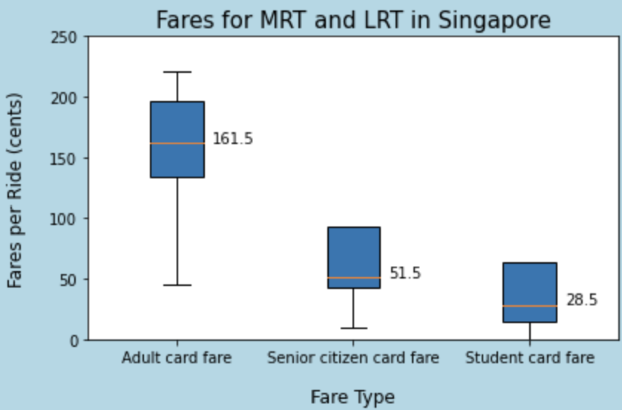
Analysis: Does Singapore Place Great Emphasis On Education?
According to the Box & Whisker Graph,
Median MRT and LRT transport fares for students is $0.285, compared to adult and senior citizen card fare of $0.1615 and $0.515 respectively.
In consideration to a student’s financial ability, government introduced lower transport fares so as to make moving around places more accessible and affordable.

Slide 14
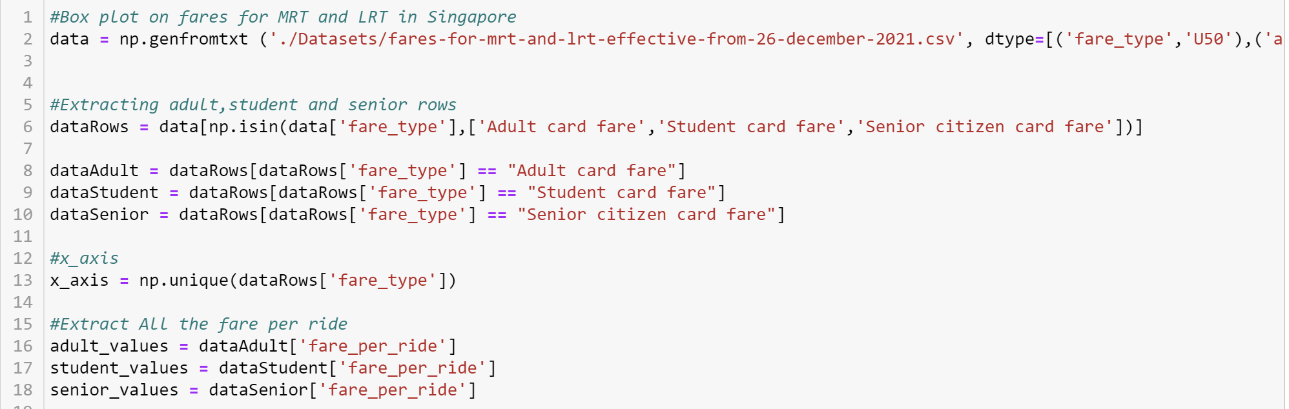
Cleansing of Data: Box Plot
Extracted only rows that are needed with np.isin
Assigned variables to adults, students and senior
X axis is then obtained using np.unique from the columns
Extract the fares of adult, student and senior
Plot the graph using matplotlib

Slide 15
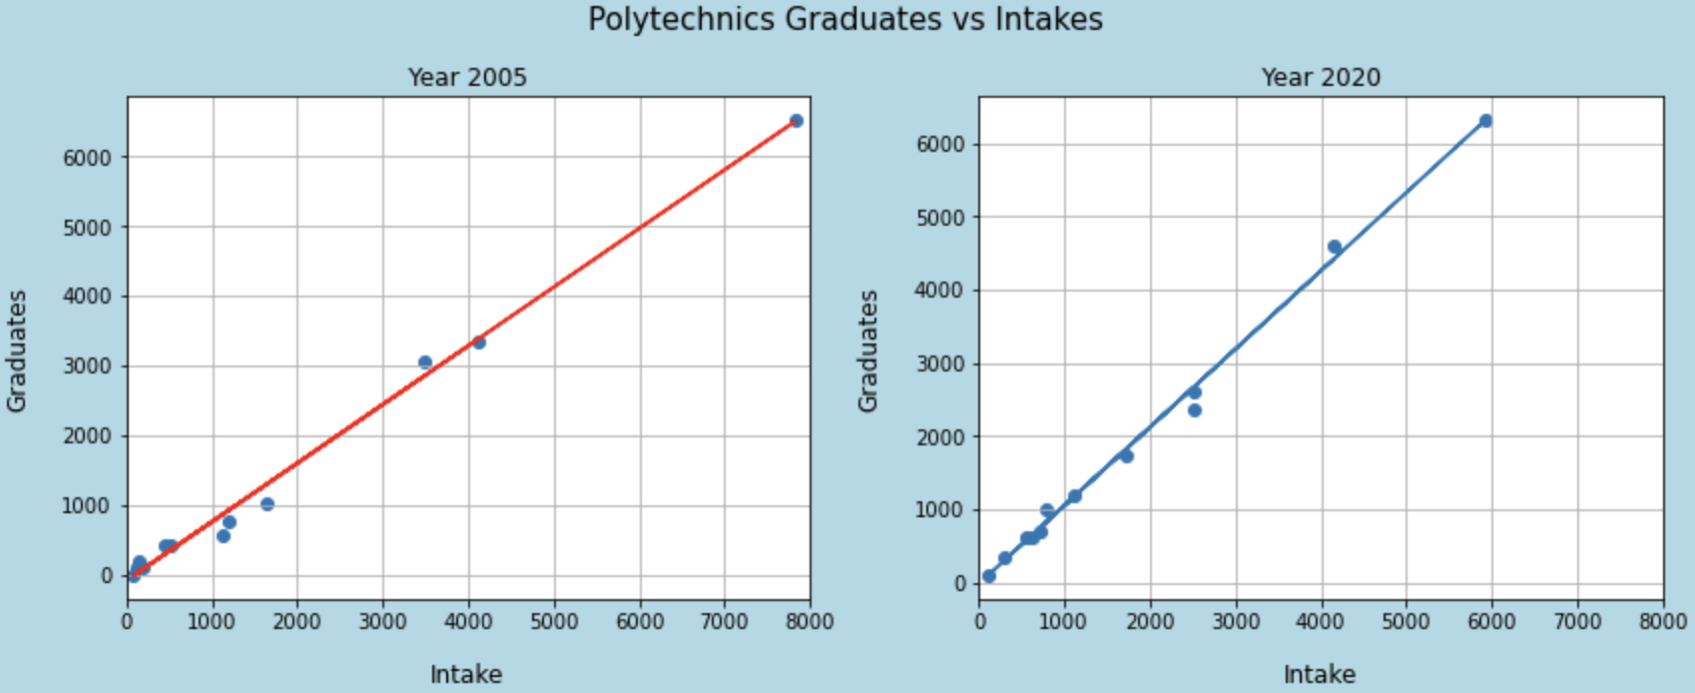
Analysis: Does Singapore Place Great Emphasis On Education?
From the scatterplot, it can be seen that Year 2020 Graduates vs Intake’s linear regression is much more steep than Year 2005 where the linear regression is gradual.
This tells us that although intakes are smaller in year 2020, the amount of graduates are still more than the amount of graduates in year 2005.
More and more students are taking education more seriously and not giving up halfway through their education

Slide 16
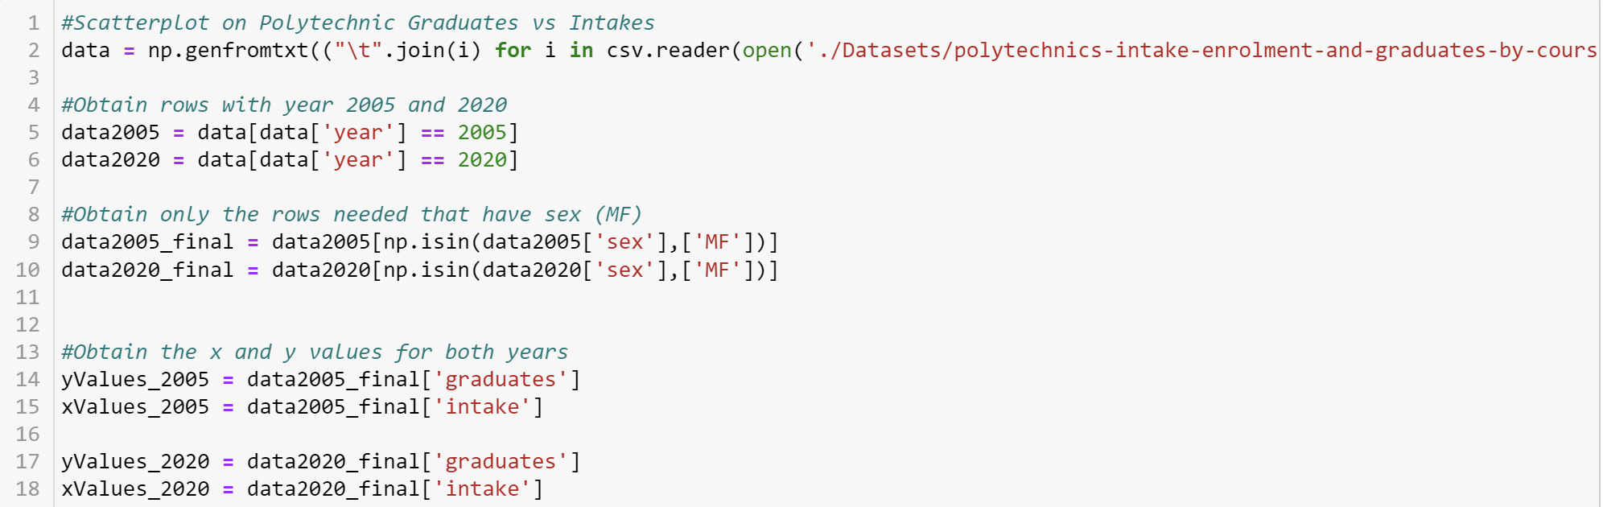
Cleansing of Data: Scatterplot
Extract the row with year 2005 and 2020.
Extract rows where sex is “MF” using np.isin
Obtain the x and y values of year 2005 and year 2020 respectively.
Plot the Graph using matplotlib

Slide 17
Conclusion
In summary of the datasets analysed,
I can safely conclude that Singapore places a great emphasis on Education.
Singapore has made tremendous effort to improved our education compared to the past.
Singapore should continue to place such emphasis on Education as it plays a role beyond Education where it affects our employability and economy at a greater scale.

Slide 18
References
Literacy Rate Dataset: https://data.gov.sg/dataset/literacy-rate-annual
Highest Qualification Attained Dataset: https://data.gov.sg/dataset/singapore-residents-aged-25-years-over-by-highest-qualification-attained-sex-and-age-group-annual
Recurrent Expenditure On Education Dataset: https://data.gov.sg/dataset/government-recurrent-expenditure-on-education
Fares for MRT and LRT Dataset: https://data.gov.sg/dataset/fare-structure-mrts-and-lrts
Polytechnic Intake Dataset: https://data.gov.sg/dataset/polytechnics-intake-enrolment-and-graduates-by-course

Slide 19
Thank you!

